Slide 1


Web app testing
Final Project
Presented by
Călinescu Andrei-Lucian
The Informal School of IT

Slide 2

What is ?
- one of the biggest e-commerce retail chain in Romania
- started by only selling IT related products such as printers, computers and components
- over the years it began to expand in the country with huge presence in online (eMAG.ro) and offline with currently 16 showrooms across major cities
- nowadays you can find almost everything on the site and have it delivered straight to your door
This requires a high-complexity modern website with many features to browse and test across time which makes it perfect to be my test subject in this project.

Slide 3
Testing approach and testing types
Smoke testing: black-box method without actually knowing or having access to the source code for main functionalities including login-logout, account registration and operations, add to bag, shopping cart, favourite products
Exploratory testing: filtering products, search bar and account registration
Negative testing: price calculation, login, searching with invalid inputs (zero or random)
UI Testing: screen size, images size, confirmation boxes or dialogs
Component testing: end-to-end tests between main functionalities inclucding login-search-filter-add to bag-checkout-logout
Security testing: passwords hidden and complexity, email links, multi-factor authentification methods, secure connection
Compability and cross-browser testing: desktop, mobile across for all test cases
API testing with Postman for main functionalities and activities for a normal user: pick product,add to bag, remove, logout
Regression and automated testing using Cypress with JavaScript
Manual test cases plan and test reporting
Bugs overview and possible improvements

Slide 4
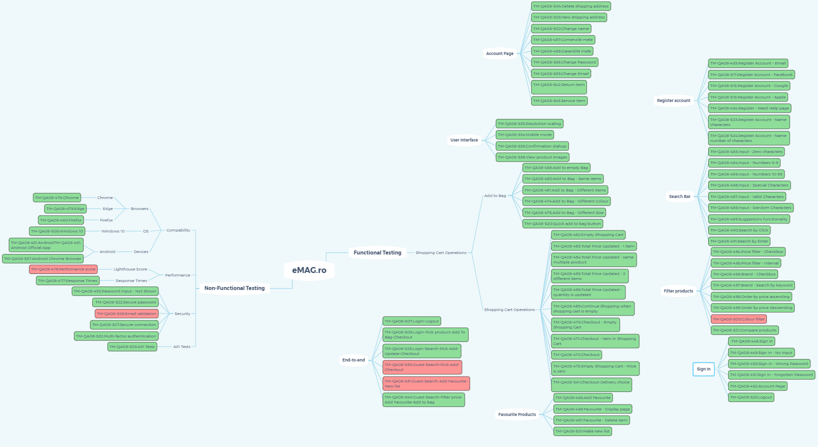
Test Cases
Site mind map→ link
Testing mind map → link

Slide 5
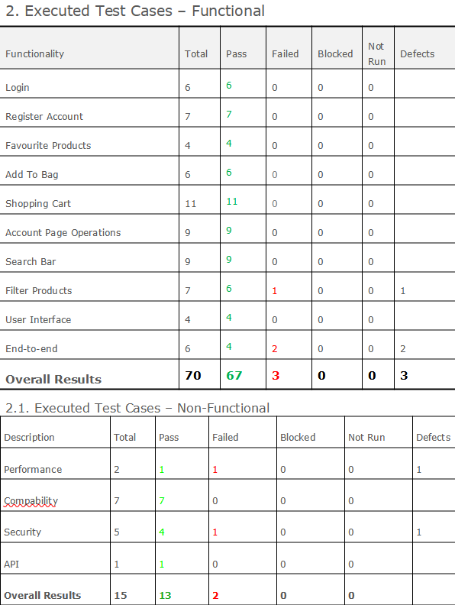
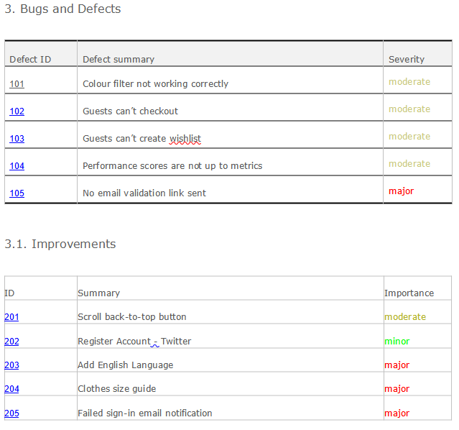
Test Results // Bugs and Improvements

Slide 6
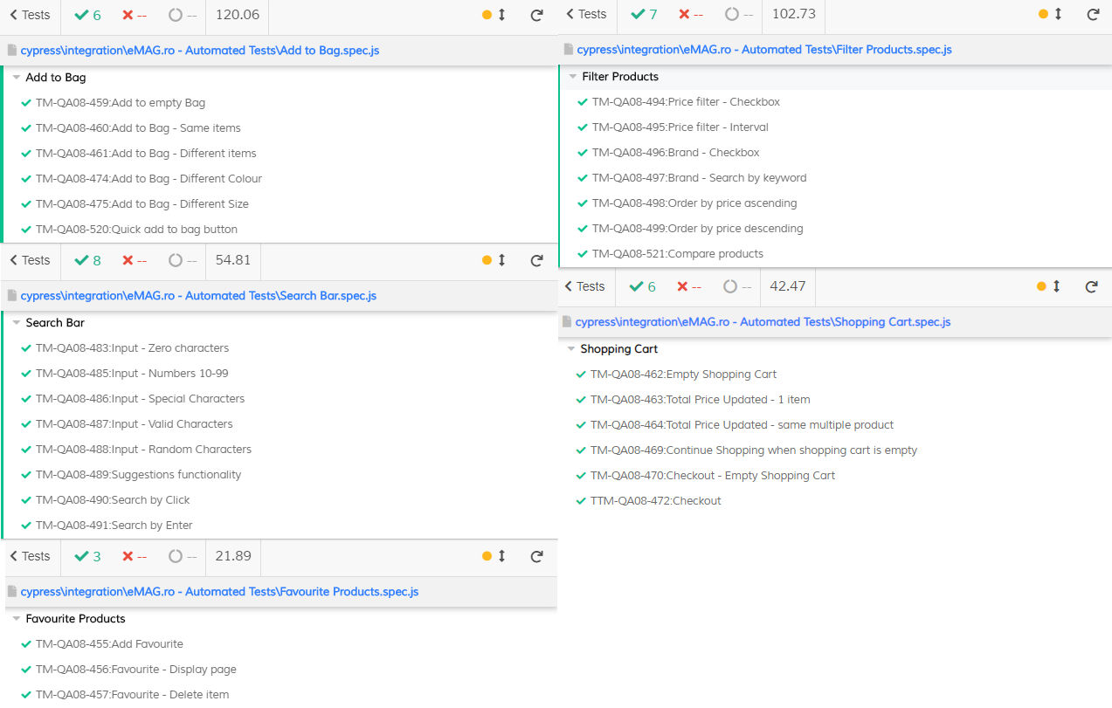
Automated Tests - Cypress

Slide 7
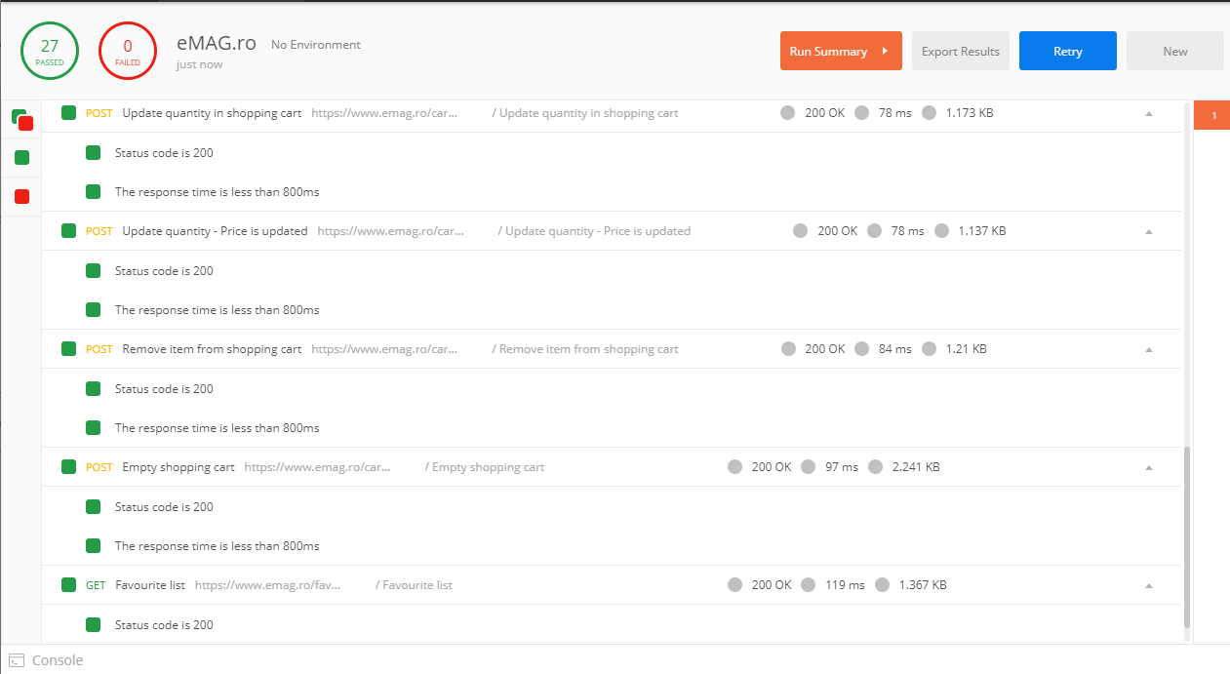
Automated Tests – API Postman

Slide 8
Tools used
Xmind – created the site mindmap and it’s main features which helped create the testing mindmap
Libreoffice – open-source tool for creating this presentation, test report, bugs and improvements tracking
Snipping Tool – screenshots
ScreenToGif – gif recording tool
TestLink – test case management and executiuon
Postman and DevTool – API testing
Cypress – automating manual tests

Slide 9
Conclusions
- 85 test cases were created and executed: functional tests: 67 passed, 3 failed;
non-functional tests: 13 passed, 2 failed;
- 30 manual test cases were automated in Cypress: 30 passed;
- 5 bugs were found with four of them identified as moderate and one as major severity; the major severity bug is related to security and is recommended to be fixed first; colour filters needs to be checked
- compability tests across devices and browsers and the bugs are present
- end-to-end testing provided two trivial bugs: a guest cannot checkout and finish an order;
a guest cannot make a new wishlist for his products; most shopping sites are allowing guest users to finish a order without actually creating an account so this can be improved
- performance measures not following set metrics

Slide 10
Lessons
- start with a mindmap; it’s easier to find and display the layout of the application and helps tracking test cases
- do as much exploratory testing in a set timeframe for a functionality: 10 minutes can be best
- because of this application changing everyday(price,name,format,UI etc.) and is already in production, be sure to review your manual and automated often test because they are subject to change their results
- simple and clear when writing test cases, comment your code
- understand priority of the workflow and ask questions
- keep it organized

Slide 11
Thank you!
Feedback appreciated :)

